Slide 1

Getting Down to Business
Grants and Reporting
Mary Magnuson
Broadband Program Administrator
Blandin Foundation
Notes:
Introduce myself – my role.
Talk about the difference between grant requirements and IRBC program requirements
Say that in the past we’ve asked for quarterly written reports from the BBC Steering Committee, but instead this time around…

Slide 2
“Strut Your Stuff” tour
Semi Annual Visits
Notes:
Starting with the MIRC evaluator tour back in 2011 & 2013, we’ve visited our communities. In 2014, we decided to visit all of our BBCs at the end of the project period, and did so again in 2016. We found the experience extremely valuable both for us and for the communities.

Slide 3
Strut Your Stuff…
~ July 2017 … Winter 2017-18 … June 2018 ~
(FUN) Two-hour gathering
  Welcome / networking
  Introductions
  Community presentation
  Response / discussion

Slide 4
Strut Your Stuff…
Steering Committee Activity Update
  Who was involved
  Planning process
  PCs for People Update
Status of your community’s grant projects
  Significant accomplishments
  Challenges
How can the Blandin Team assist you?
  What should we be aware of?
  Significant learnings / most fun

Slide 5
Funding for BBC Projects
Grants!

Slide 6
Funds Available in 2017-18
Grant Funds for IRBCs:
IRRRB: $370,000
Blandin Foundation: up to $200,000
Other Blandin Broadband Grants: up to $750,000
Blandin Broadband Communities tbd (4)
Statewide Rural grants
Notes:
The lower section in gray is anticipated – but not guaranteed.

Slide 7
Who Can Apply?
The organization named as sponsor in the IRBC program application
All applicants must be:
  IRS Status of 501(c)3
  Tribal Government
  Unit of Government

Slide 8
Application is a Two-Phase Process
Phase I:
  Project ideas will be submitted to, and vetted by, the local IRBC Steering Committee. Projects endorsed by the Steering Committee will be included in the full grant application to the Blandin Foundation.

Slide 9
Application is a Two-Phase Process
Phase II:
  Each IRBC will submit one grant application to Blandin Foundation.
  Grant applications will be reviewed by the Blandin Broadband Strategy Board. The Strategy Board will consider applications in light of community priorities along with some standard evaluation criteria.

Slide 10
Grant Application Deadlines
April 7
  Early May decision
September 15
  Mid-October decision
Notes:
We may add a December/January deadline

Slide 11
Grant Matching Requirements
25% of total project cost (1:3)
  Projects with community-wide, cross-sector benefit (most projects)
50% of total project cost (1:1)
  Projects heavy on equipment purchase
  Robust Network Feasibility Fund grants
Projects that demonstrate more than the minimum required match will be viewed favorably

Slide 12
Grant Classifications
Full Board Grant: $10,001+
  ‘Regular’ final report
  Budget Worksheet required
Small Grant: $1,001-$10,000 (less common)
  Less detailed final report
  No Budget Worksheet
Donation: less than $1,000 (very uncommon)

Slide 13
Grant Reporting
Final Narrative Report: due one month after the end of the grant period.
  Grant outcomes
  Community improvement efforts
  Healthy community indicators: Expand Opportunity
  Lessons Learned
Budget Worksheet
Notes:
This is for grants over $10,001

Slide 14
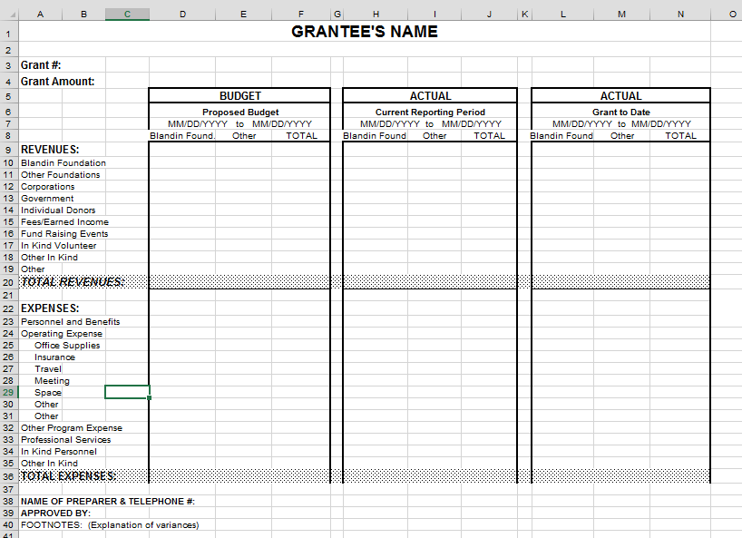
Grant Reporting

Slide 15
BBC Grant Application Instructions
How to Apply

Slide 16
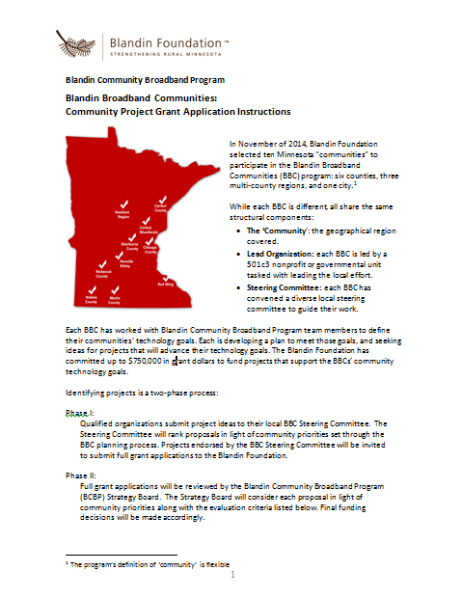

Slide 17
Grant Application Key Items
What is your project’s name?
Project Summary (2-3 sentences):

Slide 18
Grant Application Key Items
Organization Information
Purpose of Grant
  Describe how your proposal fits your community’s technology goals.
  Project goals
  Strategies to achieve the goals
Assessment
Budget and sources of funding
Attachments

Slide 19
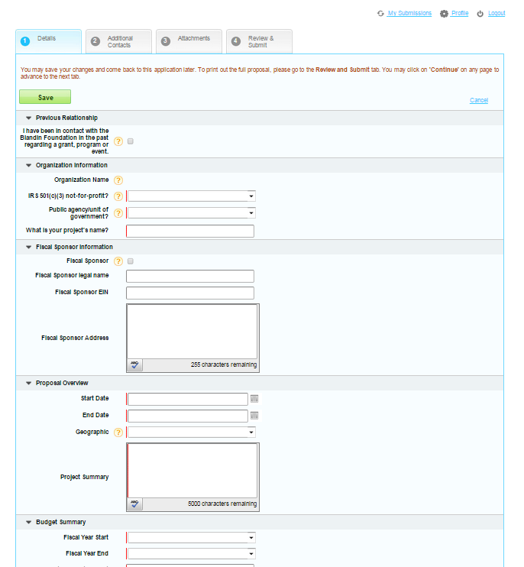
Grant Application Portal

Slide 20
Questions

